Slide 1
Chapter 8:-
IP SECURITY E-MAIL SECURITY:
Compiled By:- Akash Mehta
GIT.

Slide 2
Outline
IP Security Overview
Architecture
Authentication Header
Encapsulation
Security Payload
Combining Security Association
Key Management
Pretty Good Privacy
S/Mime And Types
Akash Mehta

Slide 3
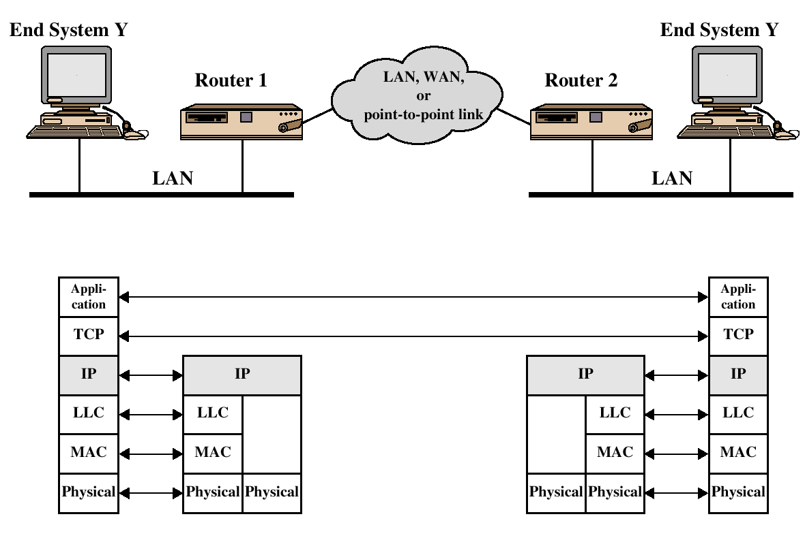
TCP/IP Example
Akash Mehta

Slide 4
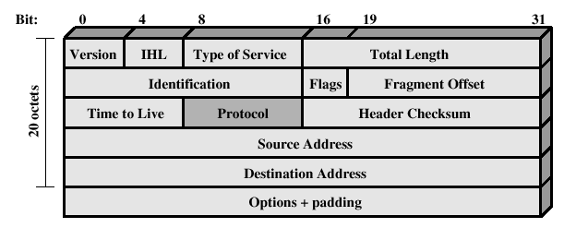
IPv4 Header
Akash Mehta

Slide 5
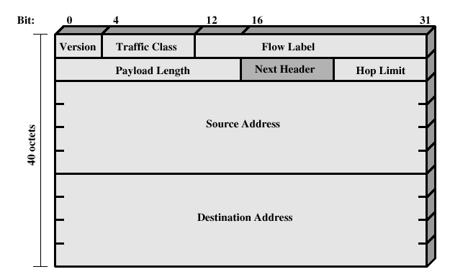
IPv6 Header
Akash Mehta

Slide 6
IP Security Overview
IPSec is not a single protocol.
Instead, IPSec provides a set of security algorithms plus a general framework that allows a pair of communicating entities to use whichever algorithms to provide security appropriate for the communication.
Applications of IPSec
  Secure branch office connectivity over the Internet
  Secure remote access over the Internet
  Establsihing extranet and intranet connectivity with partners
  Enhancing electronic commerce security
Akash Mehta

Slide 7
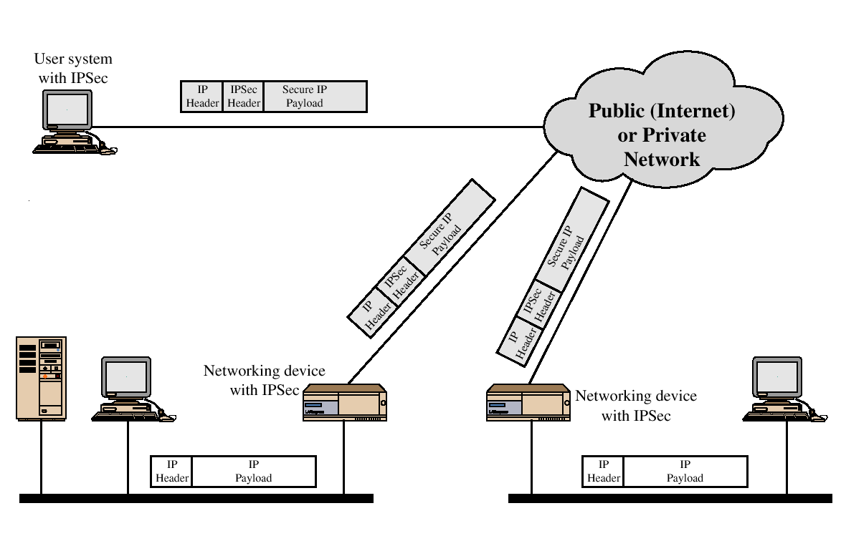
IP Security Scenario
Akash Mehta

Slide 8
IP Security Overview
Benefits of IPSec
  When IPSec is implemented in a firewall or router, it provides strong security.
  IPSec in a firewall is resistant to bypass if all traffic from the outside must use IP, and the firewall is the only means of entrance from the Internet into the organization.
  IPSec is below the transport layer (TCP, UDP) and so is transparent to applications. There is no need to change software on a user or server system when IPSec is implemented in the firewall or router. Even if IPSec is implemented in end systems, upper-layer software, including applications, is not affected.
  IPSec can be transparent to end users. There is no need to train users on security mechanisms, issue keying material on a per-user basis, or revoke keying material when users leave the organization.
Akash Mehta

Slide 9
IP Security Architecture
IPSec documents: NEW updates in 2005!
  The IPSec specification consists of numerous documents. The most important of these, issued in November of 1998, are RFCs 2401, 2402, 2406, and 2408:
  RFC 2401: An overview of a security architecture
  RFC 2402: Description of a packet authentication extension to IPv4 and IPv6
  RFC 2406: Description of a packet encryption extension to IPv4 and IPv6
  RFC 2408: Specification of key management capabilities
Akash Mehta

Slide 10
IP Security Architecture
Architecture: Covers the general concepts, security requirements, definitions, and mechanisms defining IPSec technology.
Encapsulating Security Payload (ESP): Covers the packet format and general issues related to the use of the ESP for packet encryption and, optionally, authentication.
Authentication Header (AH): Covers the packet format and general issues related to the use of AH for packet authentication.
Encryption Algorithm: A set of documents that describe how various encryption algorithms are used for ESP.
Authentication Algorithm: A set of documents that describe how various authentication algorithms are used for AH and for the authentication option of ESP.
Key Management: Documents that describe key management schemes.
Domain of Interpretation (DOI): Contains values needed for the other documents to relate to each other. These include identifiers for approved encryption and authentication algorithms, as well as operational parameters such as key lifetime.
Akash Mehta

Slide 11
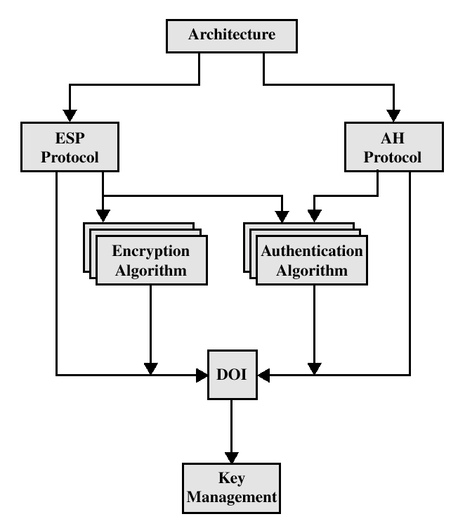
IPSec Document Overview
Akash Mehta

Slide 12
IPSec Services
Access Control
Connectionless integrity
Data origin authentication
Rejection of replayed packets
Confidentiality (encryption)
Limited traffic flow confidentiallity
Akash Mehta

Slide 13
Security Associations (SA)
A one way relationship between a sender and a receiver.
Identified by three parameters:
  Security Parameters Index (SPI)
  IP Destination address
  Security Protocol Identifier
Akash Mehta

Slide 14
SA Parameters
Sequence Number Counter
Sequence Counter Overflow
Anti-Replay Window
AH Information
ESP Information
Lifetime of This Security Association
IPSec Protocol Mode: Tunnel, transport
Path MTU (Max Trans. Unit)
Akash Mehta

Slide 15
Transport and Tunnel Modes
Transport Mode
  Transport mode provides protection primarily for upper-layer protocols. That is, transport mode protection extends to the payload of an IP packet.
Tunnel Mode
  Tunnel mode provides protection to the entire IP packet.
Akash Mehta

Slide 16
 | Transport Mode SA | Tunnel Mode SA
AH | Authenticates IP payload and selected portions of IP header and IPv6 extension headers | Authenticates entire inner IP packet plus selected portions of outer IP header
ESP | Encrypts IP payload and any IPv6 extesion header | Encrypts inner IP packet
ESP with authentication | Encrypts IP payload and any IPv6 extesion header. Authenticates IP payload but no IP header | Encrypts inner IP packet. Authenticates inner IP packet.
Akash Mehta

Slide 17
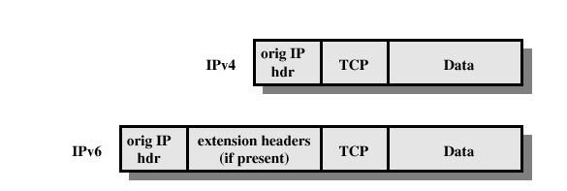
Before applying AH
Akash Mehta

Slide 18
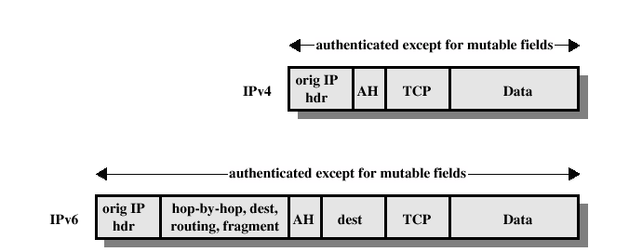
Transport Mode
(AH Authentication)
Akash Mehta

Slide 19
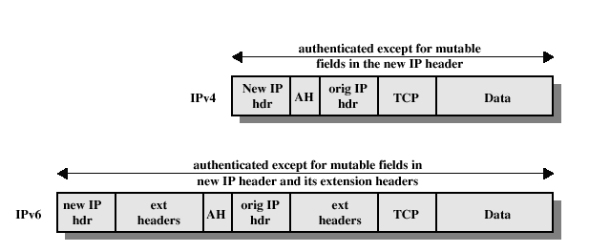
Tunnel Mode
(AH Authentication)
Akash Mehta

Slide 20
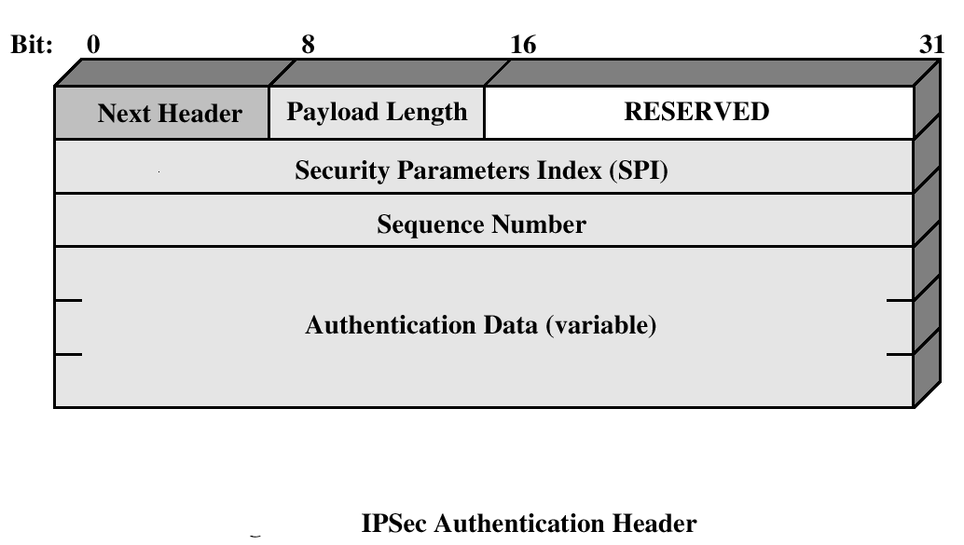
Authentication Header
Provides support for data integrity and authentication (MAC code) of IP packets.
Guards against replay attacks.
Akash Mehta

Slide 21
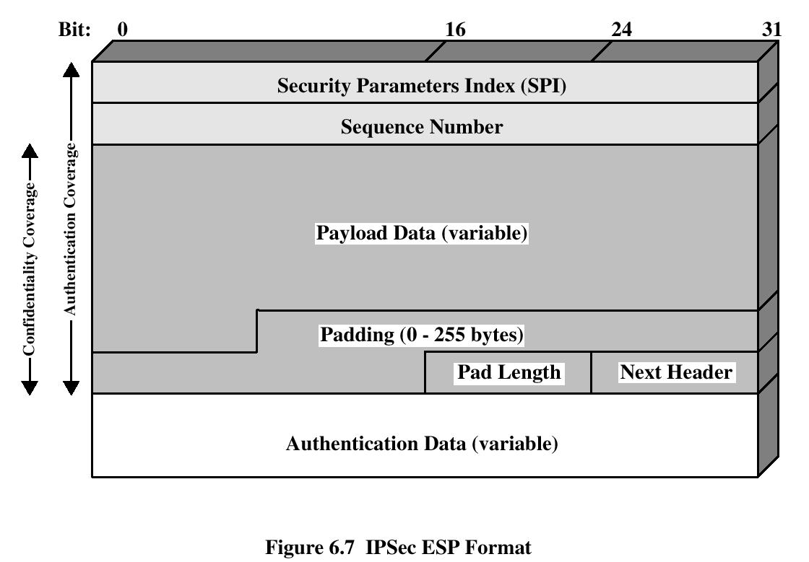
Encapsulating Security Payload
ESP provides confidentiality services
Akash Mehta

Slide 22
Encryption and Authentication Algorithms
Encryption:
  Three-key triple DES
  RC5
  IDEA
  Three-key triple IDEA
  CAST
  Blowfish
Authentication:
  HMAC-MD5-96
  HMAC-SHA-1-96
Akash Mehta

Slide 23
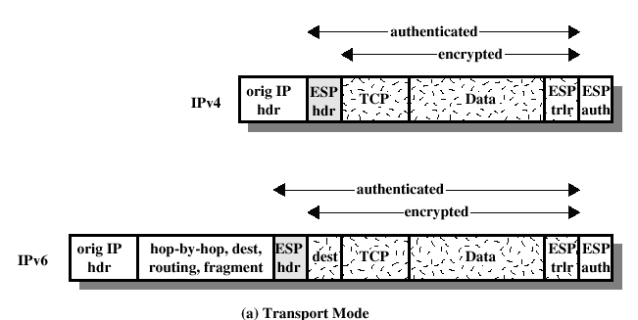
ESP Encryption and Authentication
Akash Mehta

Slide 24
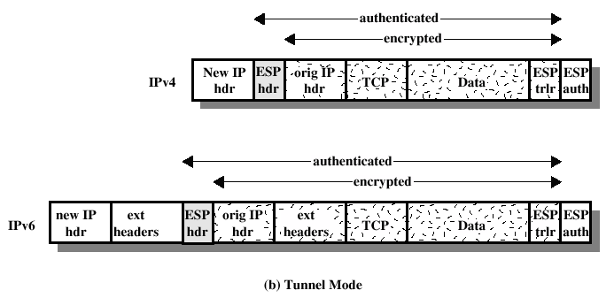
ESP Encryption and Authentication
Akash Mehta

Slide 25
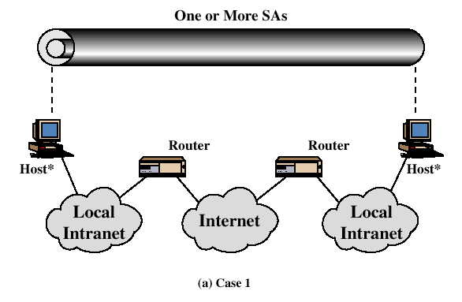
Combinations of Security Associations
In Case 1, all security is provided between end systems that implement IPSec.
Akash Mehta

Slide 26
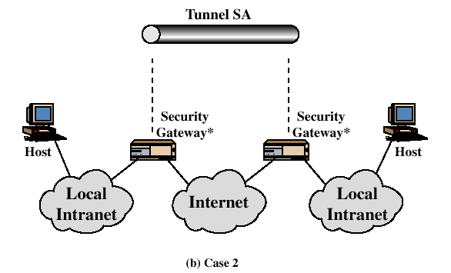
Combinations of Security Associations
For Case 2, security is provided only between gateways (routers, firewalls, etc.) and no hosts implement IPSec. This case illustrates simple virtual private network support.
Akash Mehta

Slide 27
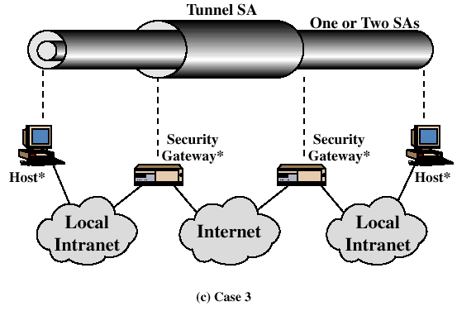
Combinations of Security Associations
Case 3 builds on Case 2 by adding end-to-end security. The same combinations discussed for cases 1 and 2 are allowed here. The gateway-to-gateway tunnel provides either authentication or confidentiality or both for all traffic between end systems.
Akash Mehta

Slide 28
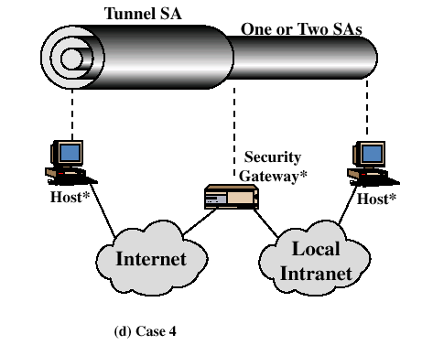
Combinations of Security Associations
Case 4 provides support for a remote host that uses the Internet to reach an organization's firewall and then to gain access to some server or workstation behind the firewall.
Akash Mehta

Slide 29
Key Management
Two types:
  Manual: A system administrator manually configures each system with its own keys and with the keys of other communicating systems. This is practical for small, relatively static environments.
  Automated: An automated system enables the on-demand creation of keys for SAs and facilitates the use of keys in a large distributed system with an evolving configuration.
    Oakley Oakley is a key exchange protocol based on the Diffie Hellman algorithm but providing added security.
    Internet Security Association and Key Management Protocol (ISAKMP)
Akash Mehta

Slide 30
Oakley
Three authentication methods:
  Digital signatures
  Public-key encryption
  Symmetric-key encryption (aka. Preshare key)
Akash Mehta

Slide 31
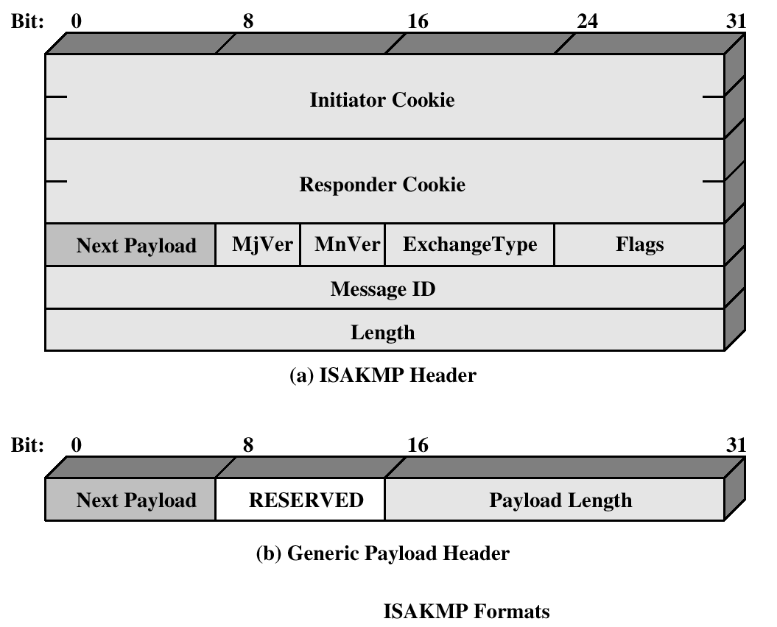
ISAKMP
Akash Mehta

Slide 32
Email Security
email is one of the most widely used and regarded network services
currently message contents are not secure
Notes:
In virtually all distributed environments, electronic mail is the most heavily used network-based application. But current email services are roughly like "postcards”, anyone who wants could pick it up and have a look as its in transit or sitting in the recipients mailbox.

Slide 33
Email Security Enhancements
confidentiality
  protection from disclosure
authentication
  of sender of message
message integrity
  protection from modification
non-repudiation of origin
  protection from denial by sender
Notes:
With the explosively growing reliance on electronic mail for every conceivable purpose, there grows a demand for authentication and confidentiality services. What we want is something more akin to standard mail (contents protected inside an envelope) if not registered mail (have confidence about the sender of the mail and its contents). That is, the “classic” security services listed are desired.

Slide 34
Pretty Good Privacy (PGP)
Open source, freely available software package for secure e-mail
de facto standard for secure email
developed by Phil Zimmermann
selected best available crypto algs to use
Runs on a variety of platforms like Unix, XP, Macintosh and other systems
originally free (now also have commercial versions available)
Notes:
The Pretty Good Privacy (PGP) secure email program, is a remarkable phenomenon, has grown explosively and is now widely used. Largely the effort of a single person, Phil Zimmermann, who selected the best available crypto algorithms to use & integrated them into a single program, PGP provides a confidentiality and authentication service that can be used for electronic mail and file storage applications. It runs on a wide range of systems, in both free & commercial versions.

Slide 35
PGP Operation – Authentication
sender creates message
Generates a digital signature for the message
use SHA-1 to generate 160-bit hash of message
signed hash with RSA using sender's private key, and is attached to message
receiver uses RSA with sender's public key to decrypt and recover hash code
receiver verifies received message using hash of it and compares with decrypted hash code
Notes:
The actual operation of PGP consists of five services: authentication, confidentiality, compression, e-mail compatibility, and segmentation.
Here see the digital signature service provided by PGP, using the steps as shown. Note this assumes use of RSA digital signatures, recent PGP versions also support the use of DSS signatures. Signatures can also be detached from a message/file and sent/stored separately.

Slide 36
PGP Operation – Confidentiality
sender generates a message and encrypts it.
Generates a128-bit random number as session key
Encrypts the message using CAST-128 / IDEA / 3DES in CBC mode with session key
session key encrypted using RSA with recipient's public key and attached to the msg
receiver uses RSA with private key to decrypt and recover session key
session key is used to decrypt message
Notes:
Another basic service provided by PGP is confidentiality, provided by encrypting messages to be transmitted or to be stored locally as files, using symmetric encryption algorithms CAST-128, IDEA or 3DES in 64-bit cipher feedback (CFB) mode. The randomly chosen session key used for this is sent encrypted using the recipient’s public RSA key. The steps used in this process are as shown. Recent PGP versions also support the use of ElGamal (a Diffie-Hellman variant) for session-key exchange.

Slide 37
PGP Operation – Confidentiality & Authentication
can use both services on the same message
  create signature & attach it to the message
  encrypt both message & signature
Notes:
Both confidentiality & authentication services may be used for the same message. Firstly a signature is generated for the plaintext message and prepended to the it. Then the plaintext message plus signature is encrypted using CAST-128 (or IDEA or 3DES), and the session key is encrypted using RSA (or ElGamal).

Slide 38
PGP Operation – Compression
PGP compresses messages to save space for e-mail transmission and storage
by default PGP compresses message after signing but before encrypting
  so can store uncompressed message & signature for later verification
  Encryption after compression strengthens security (because compression has less redundancy)
uses ZIP compression algorithm
Notes:
By default PGP compresses the message after applying the signature but before encryption. This has the benefit of saving space both for e-mail transmission and for file storage. The signature is generated before compression for the reasons shown. The compression algorithm used is ZIP, which is described in Stallings Appendix 15A.

Slide 39
PGP Operation – Email Compatibility
when using PGP will have binary data (8-bit octets) to send (encrypted message, etc)
however email was designed only for text
hence PGP must encode raw binary data into printable ASCII characters
uses radix-64 algorithm
PGP also segments messages if too big
(maximum length 50,000 octets)
Notes:
When PGP is used, at least part of the block to be transmitted is encrypted, and thus consists of a stream of arbitrary 8-bit octets. However many electronic mail systems only permit the use of ASCII text. To accommodate this restriction, PGP provides the service of converting the raw 8-bit binary stream to a stream of printable ASCII characters. It uses radix-64 conversion, in which each group of three octets of binary data is mapped into four ASCII characters. This format also appends a CRC to detect transmission errors. See Stallings Appendix 15B for a description.
PGP also automatically subdivides a message that is too large for a single email, into segments that are small enough to send.

Slide 40
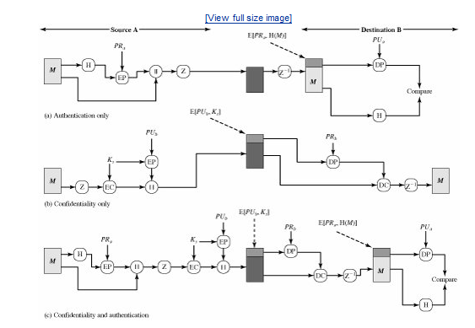
PGP Cryptographic Functions
Akash Mehta

Slide 41
K_{s} | =session key used in symmetric encryption scheme
PR_{a} | =private key of user A, used in public-key encryption scheme
PU_{a} | =public key of user A, used in public-key encryption scheme
EP | = public-key encryption
DP | = public-key decryption
EC | = symmetric encryption
DC | = symmetric decryption
H | = hash function
|| | = concatenation
Z | = compression using ZIP algorithm
R64 | = conversion to radix 64 ASCII format
Akash Mehta

Slide 42
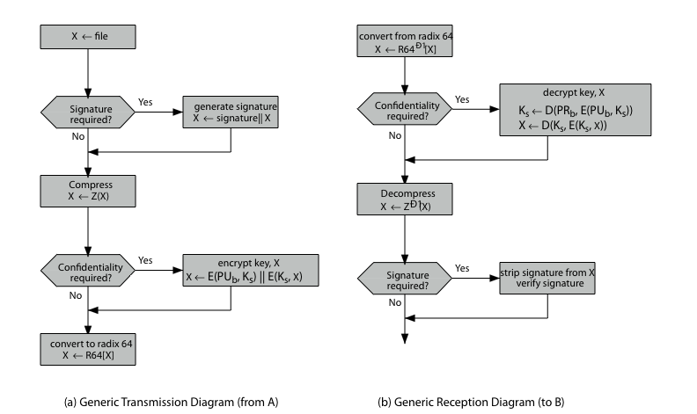
PGP Operation – Summary
Notes:
Stallings Figure 15.2 illustrates the general operation of PGP, and the relationship between the services discussed.

Slide 43
PGP Session Keys
need a session key for each message
  of varying sizes: 56-bit DES, 128-bit CAST or IDEA, 168-bit Triple-DES
uses random inputs
Notes:
PGP makes use of four types of keys: one-time session symmetric keys, public keys, private keys, and passphrase-based symmetric keys.
Each session key is associated with a single message and is used only for the purpose of encrypting and decrypting that message. Random numbers are generated using the ANSI X12.17 generator, with inputs based on keystroke input from the user, where both the keystroke timing and the actual keys struck are used to generate a randomized stream of numbers. Stallings Appendix 15C discusses PGP random number generation techniques in more detail.

Slide 44
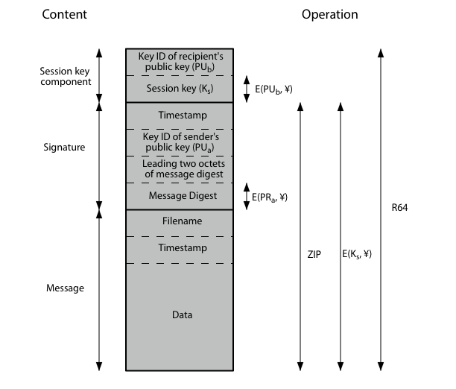
PGP Message Format
Notes:
Stallings Figure 15.3 shows the format of a transmitted PGP message. A message consists of three components: the message component, a signature (optional), and a session key component (optional).

Slide 45
S/MIME
S/MIME (Secure/Multipurpose Internet Mail Extension) is a security enhancement to the MIME Internet e-mail format standard, based on technology from RSA Data Security.
RFC 822
RFC 822 defines a format for text messages that are sent using electronic mail. It has been the standard for Internet-based text mail message and remains in common use.
Akash Mehta

Slide 46
RFC Header
Date: Tue, 16 Jan 1998 10:37:17 (EST) From: "William Stallings" <ws@shore.net> Subject: The Syntax in RFC 822 To: Smith@Other-host.com Cc: Jones@Yet-Another-Host.com Hello. This section begins the actual message body, which is delimited from the message heading by a blank line.
Akash Mehta

Slide 47
Multipurpose Internet Mail Extensions
MIME is an extension to the RFC 822 framework that is intended to address some of the problems and limitations of the use of SMTP (Simple Mail Transfer Protocol) or some other mail transfer protocol and RFC 822 for electronic mail.
Akash Mehta

Slide 48
Overview S/MIME
The MIME specification includes the following elements:
Five new message header fields are defined, which may be included in an RFC 822 header. These fields provide information about the body of the message.
A number of content formats are defined, thus standardizing representations that support multimedia electronic mail.
Transfer encodings are defined that enable the conversion of any content format into a form that is protected from alteration by the mail system.
Akash Mehta

Slide 49
The five header fields defined in MIME are as follows:
MIME-Version: Must have the parameter value 1.0. This field indicates that the message conforms to RFCs 2045 and 2046.
Content-Type: Describes the data contained in the body with sufficient detail that the receiving user agent can pick an appropriate agent or mechanism to represent the data to the user or otherwise deal with the data in an appropriate manner.
Content-Transfer-Encoding: Indicates the type of transformation that has been used to represent the body of the message in a way that is acceptable for mail transport.
Content-ID: Used to identify MIME entities uniquely in multiple contexts.
Content-Description: A text description of the object with the body; this is useful when the object is not readable (e.g., audio data).
Akash Mehta

Slide 50
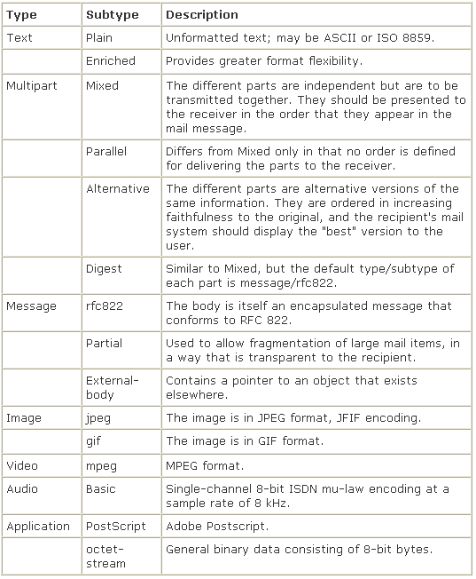
Akash Mehta

